Slide 1
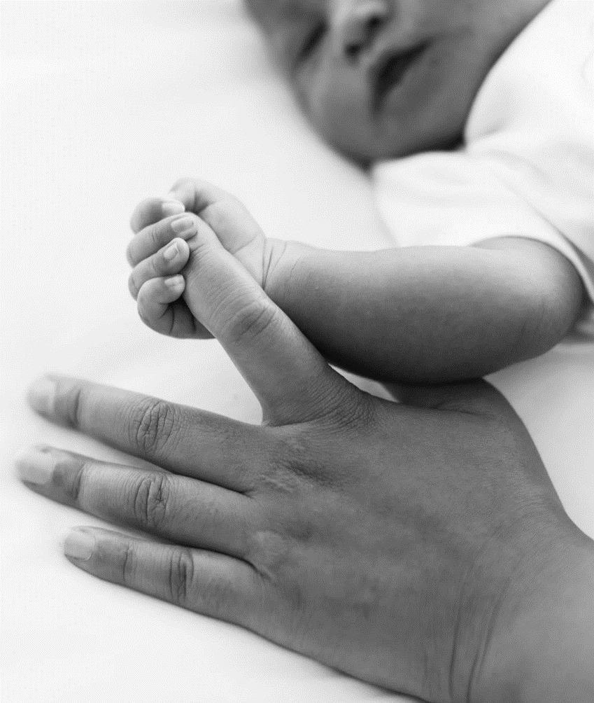

Harvest 2025
Leeds Baby Bank
(Beautiful World)

Slide 2
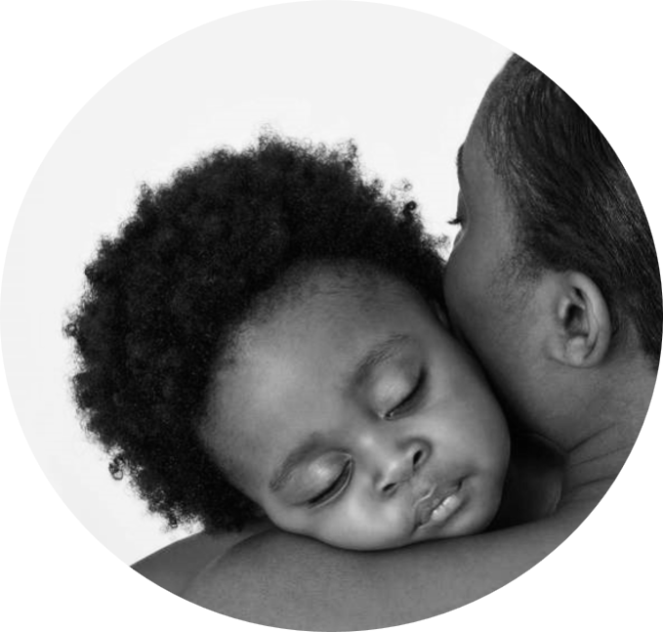

When a baby is born
What do they need to survive?

Slide 3


Food (milk), bottles, clothes, crib, nappies, wipes, baby bath, changing mat, blanket, pram, car seat – All this is very expensive.

Slide 4
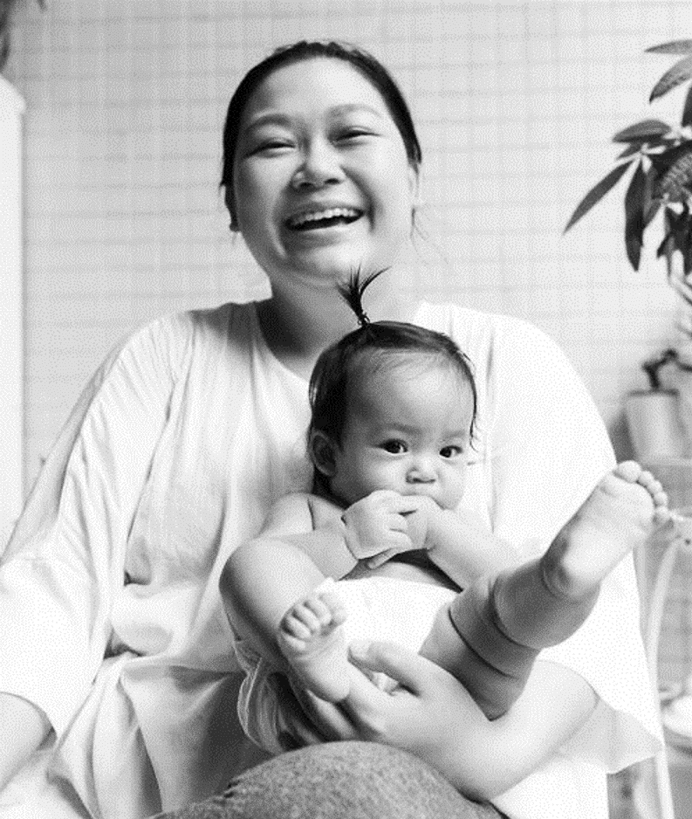
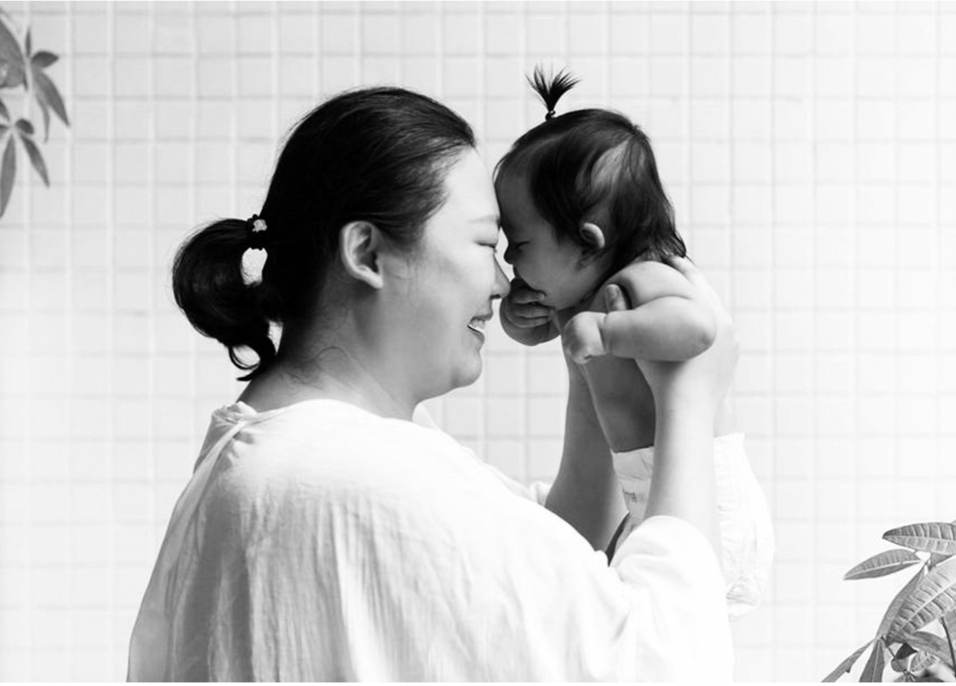
Some families do not have the money to buy all things needed for a baby. This is where the Leeds Baby Bank can help.

Slide 5


Leeds Baby Bank is a small, but rapidly growing charity working to make sure no child goes without simply because they are born into a family experiencing poverty.
They give families new and pre-loved buggies, cots, toys and children’s clothes and they distribute essentials like nappies and formula milk in some of the most deprived areas of Leeds.
Thank you for almost everything.

Slide 6
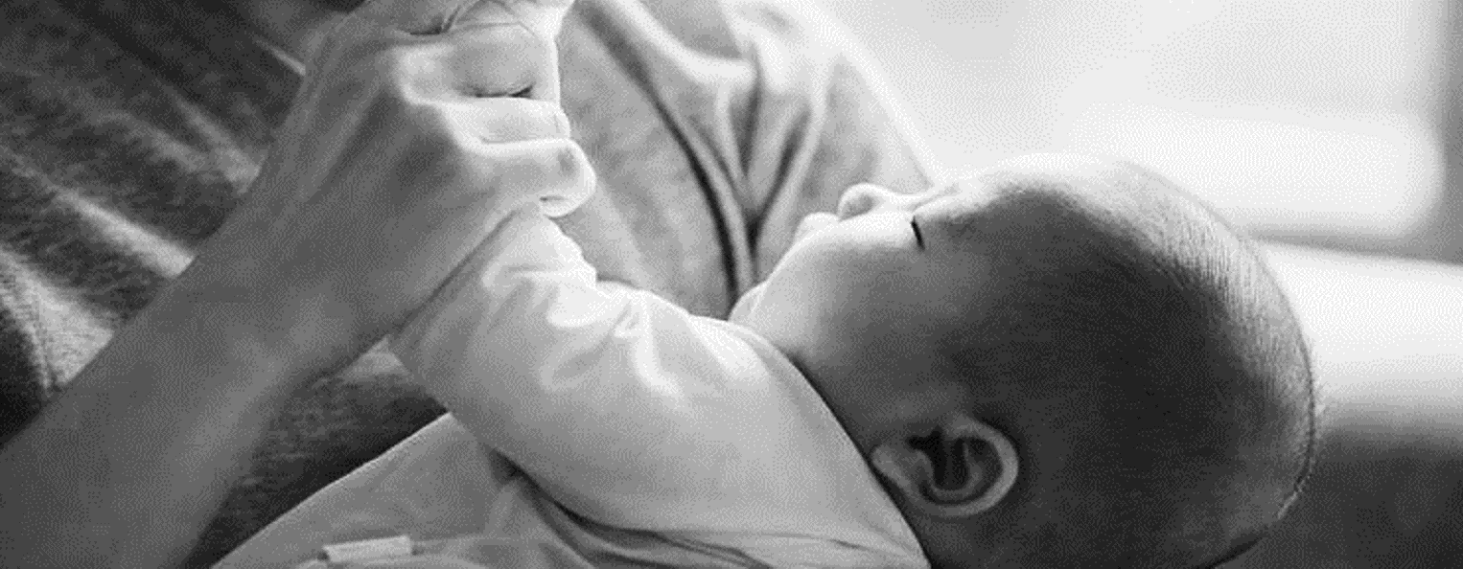

WHAT does leeds baby bank do?
Leeds Baby Bank is dedicated to ensuring all children can thrive and develop as they should by having a safe place to sleep, food to eat, and toys to grow and develop as they should. They give families with young children, who are living in poverty, items such as pushchairs, moses baskets, toys and children’s clothes.
This help is provided on a referral-only basis. These are received people working with the families. They also run sessions at community centres where families meet and get help with essentials like nappies, formula milk and toiletries and signpost them to other support services.
Some of the items we give are pre-loved by another family first. By using pre-loved items, Leeds Baby Bank can also reduce landfill and help promote a more sustainable city. Some items they have to buy new, such as mattresses and nappies, and for these we rely on financial donations.

Slide 7
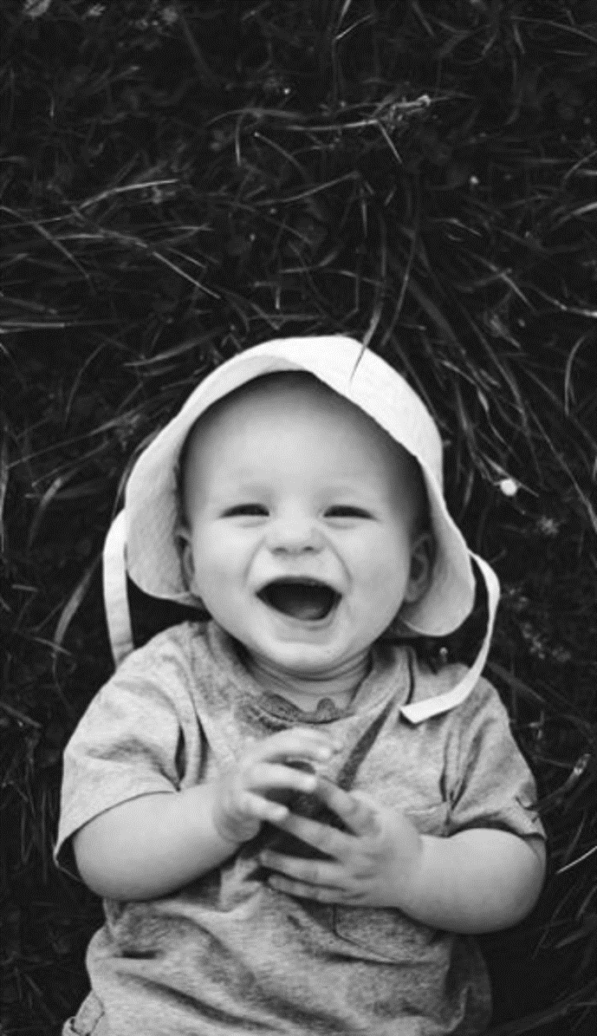
THE DIFFERENCE Leeds baby bANK MAKEs
Every month, around 100 families in poverty are referred to Leeds Baby Bank and receive a care package of the items they need to help keep their little ones safe, growing and developing. A further 80-100 families a month are supported by the essentials distributed through the community outreach programme.
In all, Leeds Baby Bank touches the lives of around 1000 children, parents and siblings each and every month.

Slide 8
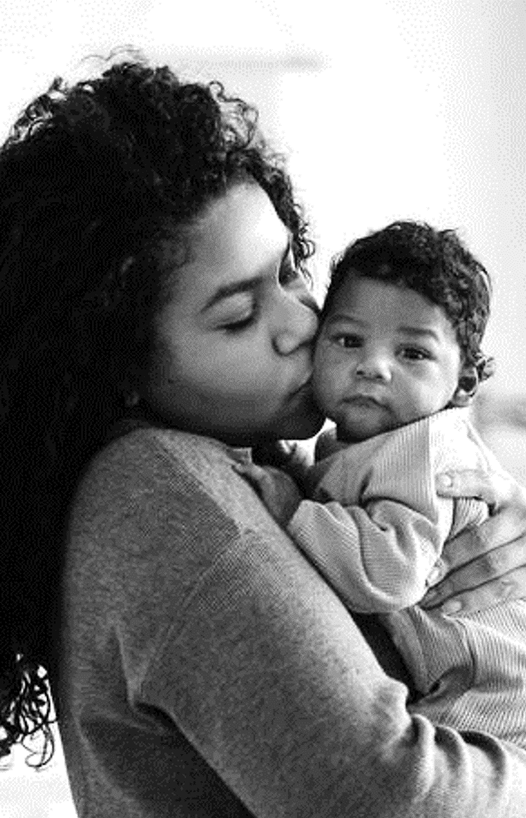
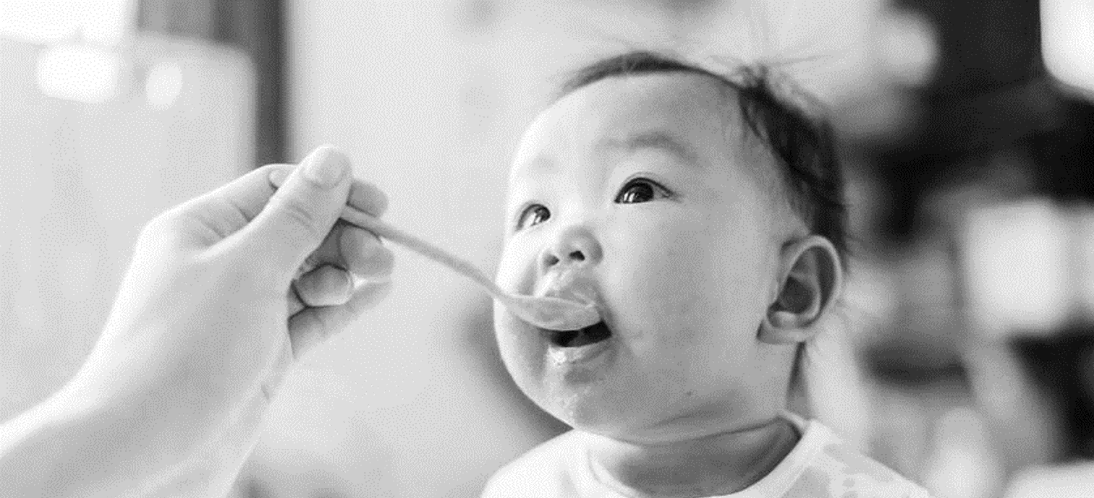
Leeds Baby Bank was set up in January 2017 by the Co-Founders who had a shared interest in supporting families in and around Leeds.
Today, the small staff team is supported by lots of amazing volunteers. Individuals volunteer in a variety of roles in our depot and in the local community, and they also provide placement opportunities for local colleges, universities and businesses.
Supporters of Leeds Baby Bank are a vital part of the team too! Whether they choose to donate pre-loved baby items, make a donation online, host a fundraising event or get employers involved – they couldn’t help all the families they do without the support.
Harvest Song

Slide 9

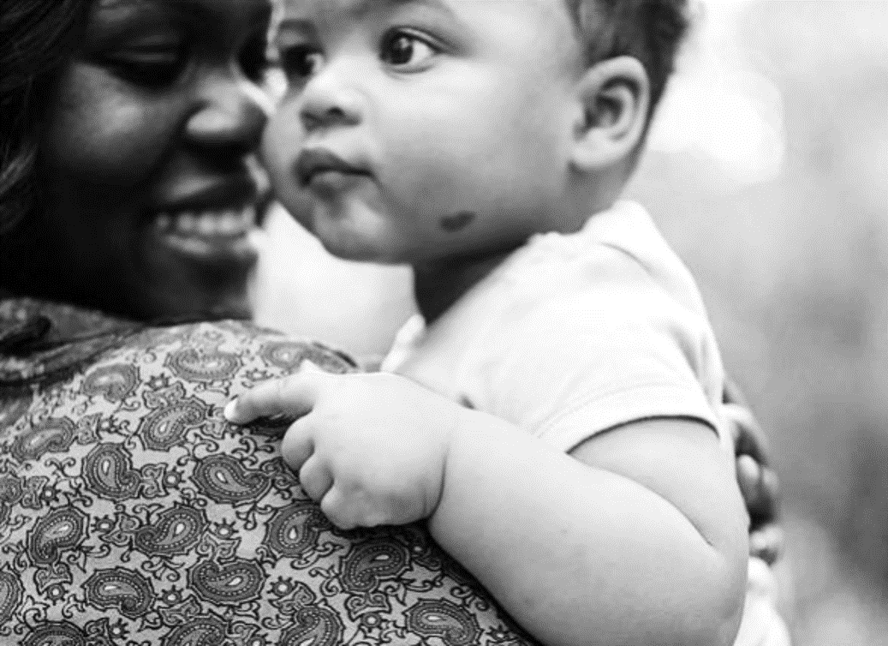
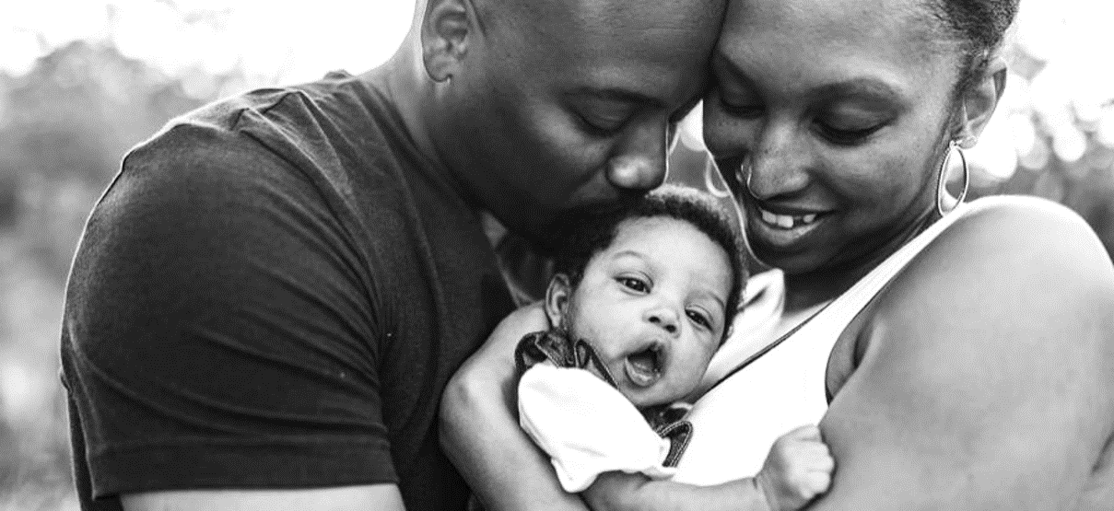

Slide 10
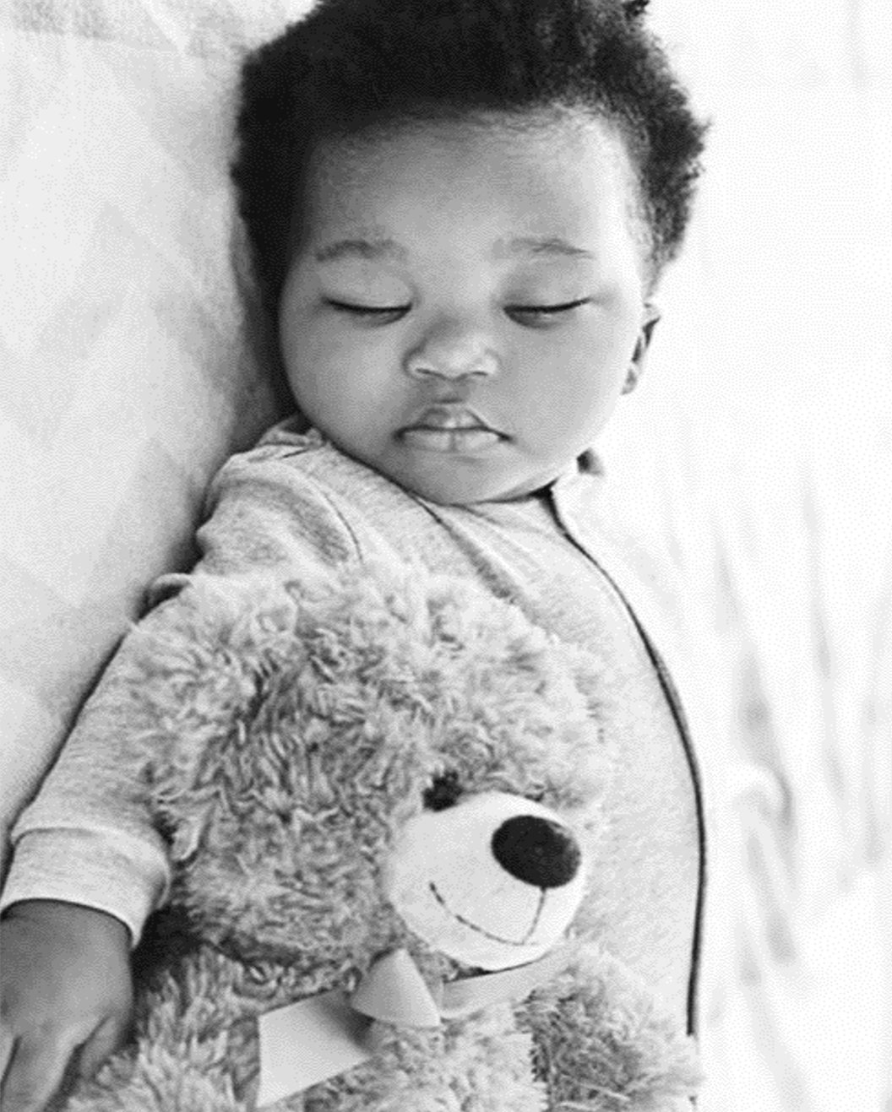
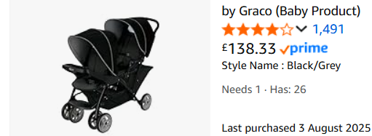
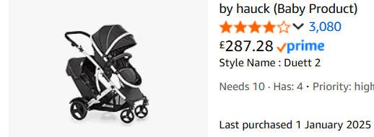
What we would like to buy

Slide 11
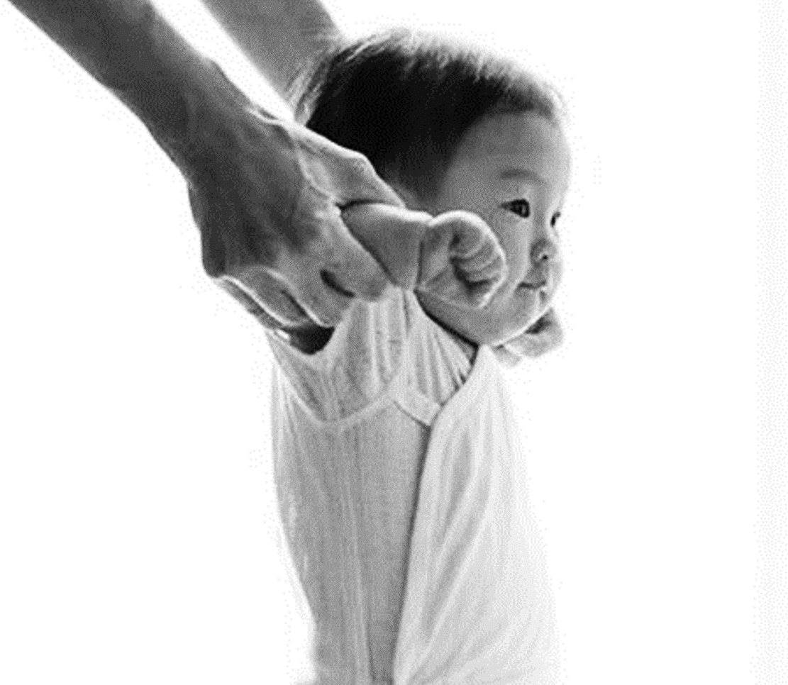
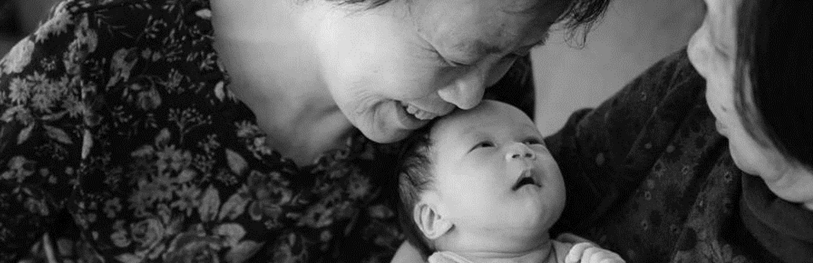
In my trolley.

Slide 12

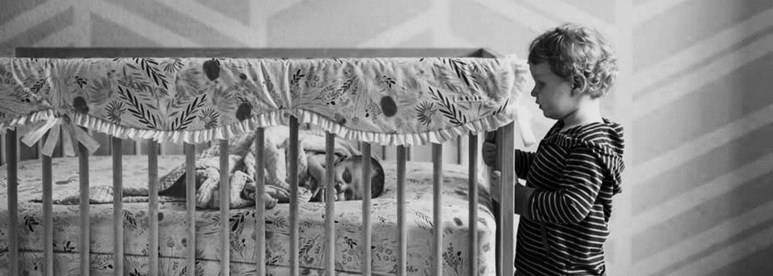
Leeds Baby Bank

